Slide 1
Business Advisory to invest in Private or Private Airplanes
Using the data from the National Transportation Safety Board, including aviation accident data from 1962 to 2023.
This data was analysed to determine if investors can invest in private or public aeroplanes.

Slide 2
Objective of the Investment
To determine the type of business to invest in, I.e private or public airplanes:
Determine the best model to airplane to be purchased
Establish the weather conditions that will minimise the cost of operating the planes

Slide 3
Data Analysis
The data collected and analysed revealed the following;
During the weather season described as VMC, there were more fatal injuries, minor injuries and completed with serious injuries
The Cessna type of aeroplane had more injuries than any other model plane, with the highest being fatal injuries.
Airplanes with reciprocating engine types caused more injuries
Personal accidents occurred more than the private or executive planes

Slide 4
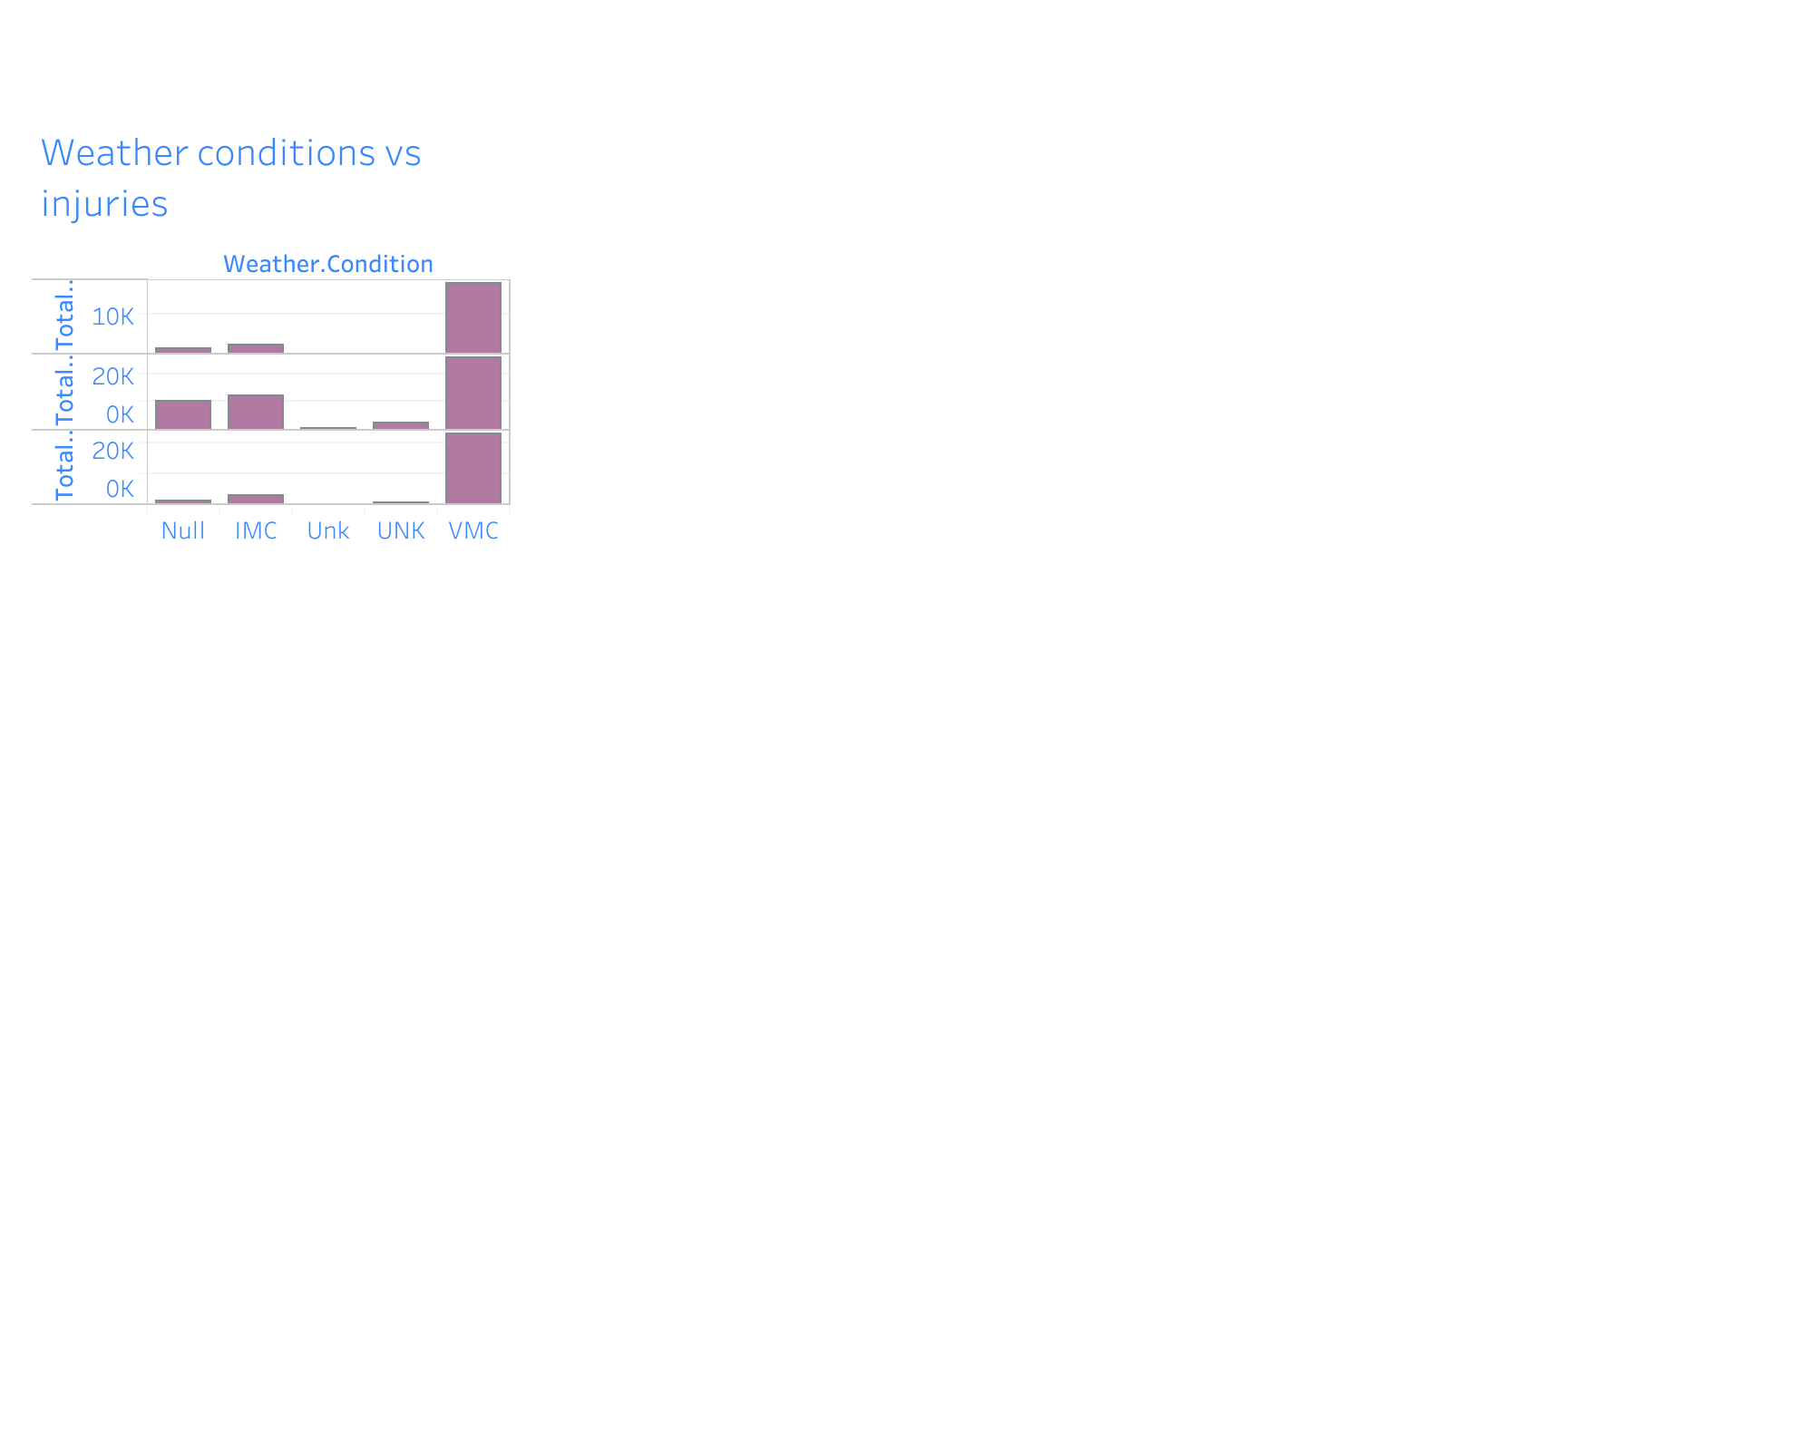

Slide 5
Recommendations
The following are the key recommendations;
Schedule flights in other regions except VMC
Review the Model of planes used with minimum consideration to purchase a Cessna flight type
Do not purchase flights running on a reciprocating engine type
. Invest in commercial planes since they are least prone to fatal injuries, and customers will prefer commercial flights to private ones.

Slide 6
Recommendations
The following are the key recommendations;
Schedule flights in other regions except VMC
Review the Model of planes used with minimum consideration to purchase a Cessna flight type
Do not purchase flights running on a reciprocating engine type
. Invest in commercial planes since they are least prone to fatal injuries, and customers will prefer commercial flights to private ones.

